Slide 1
Personalized Transformer for
Explainable Recommendation
Advisor :Jia-Ling, Koh
Speaker : Shu-Ming Yu
Source : ACL 2021
Date : 2023/11/07

Slide 2
Outline
• Introduction
• Method
• Experiment
• Conclusion

Slide 3
Problem Formulation
• Explanation task: generating a sentence as explanations of recommended items for user
• Recommendation task: predicting a rating as user’s preference toward item
(1~5)
Restaurant
Great Mexican food. Nice waiters and manager.
4
Notes:
https://arxiv.org/pdf/1804.11192.pdf p.23

Slide 4
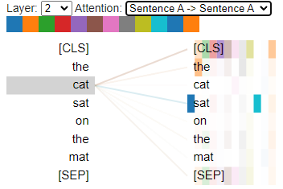
Difficulty
• IDs and words are in very different semantic spaces.
• In a standard Transformer model, each element calculates the weights to all elements.
Notes:
https://arxiv.org/pdf/1804.11192.pdf p.23

Slide 5
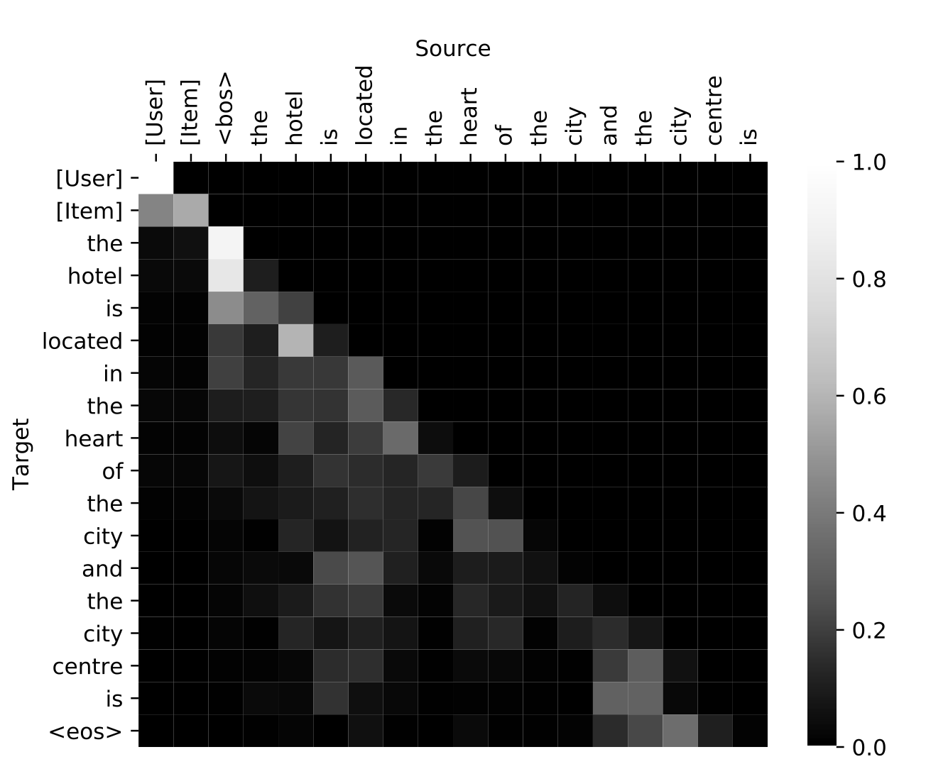
Difficulty
• IDs and words are in very different semantic spaces.
• When treated IDs as words, they have less influence on the words.
=> It would result in identical explanations over different user-item pairs
• Standard Transformer’s attention
Notes:
https://arxiv.org/pdf/1804.11192.pdf p.23

Slide 6
Overcoming difficulty
• Explanation task: transformer-based
• context prediction : predicting some words as draft
• explanation generation : polishing the words to form a readable sentence
user and item only influence draft
Notes:
https://arxiv.org/pdf/1804.11192.pdf p.23

Slide 7
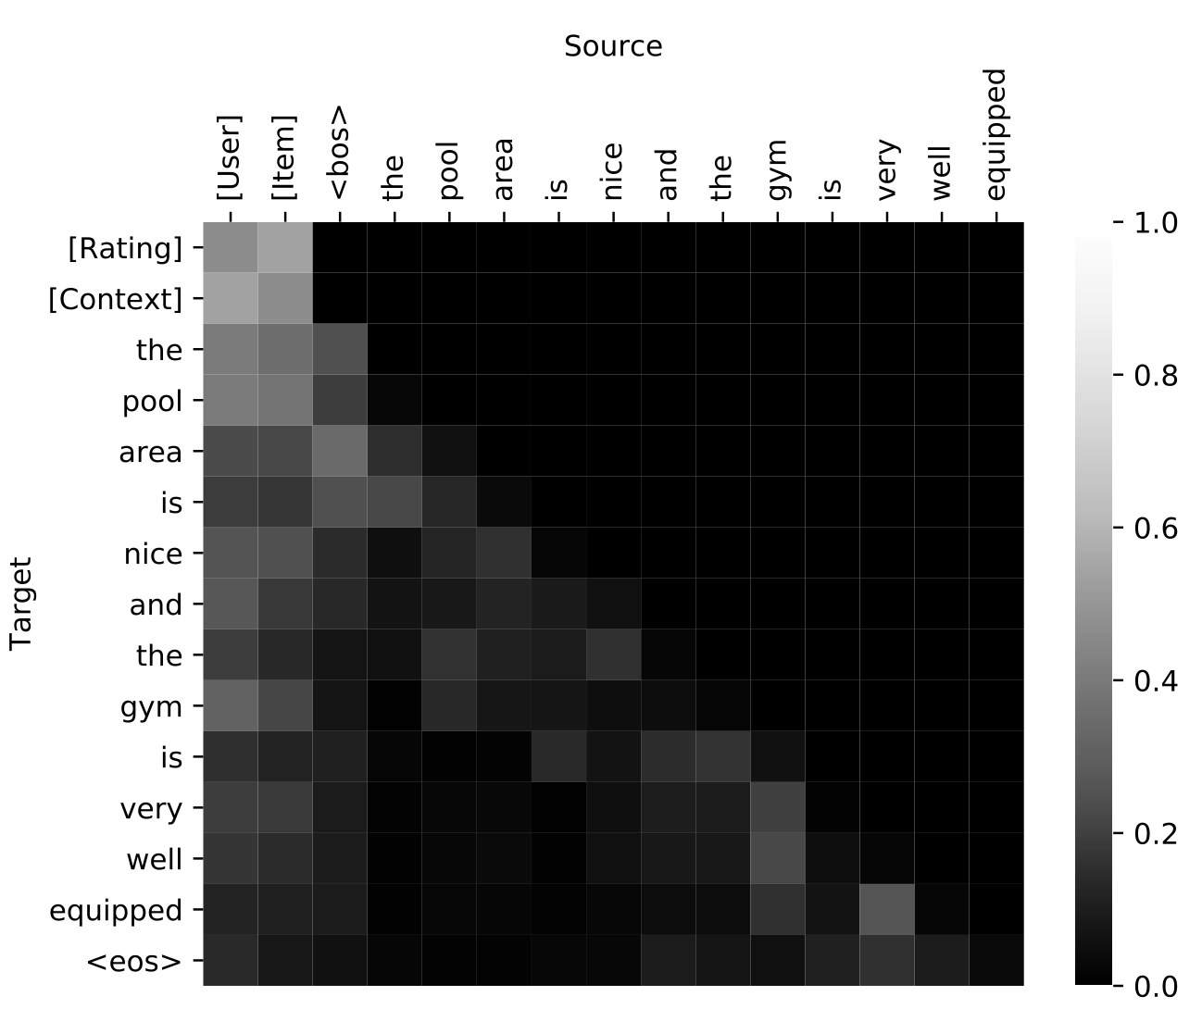
Overcoming difficulty
• Users and items only affect context prediction but do not impact the generator
• Standard Transformer’s attention
• PETER’s attention
Notes:
https://arxiv.org/pdf/1804.11192.pdf p.23

Slide 8
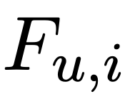
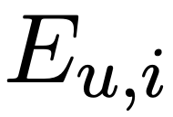
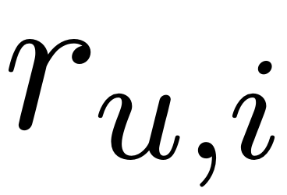
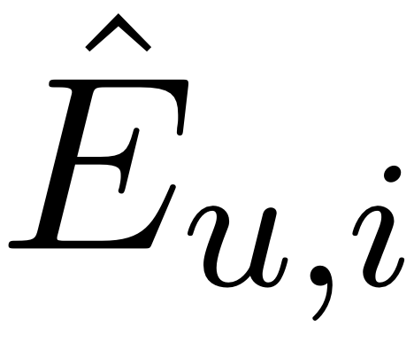
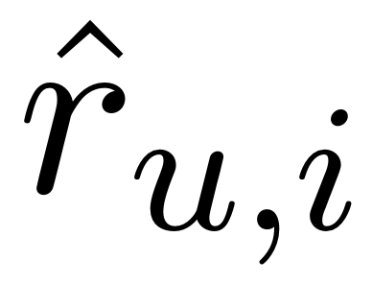
Input / Output
Input:
• user ID 𝑢
• item ID 𝑖
• item’s features
• explanation(extracted from review)
• rating
Output: • explanation
• rating

Slide 9
Outline
• Introduction
• Method
• Experiment
• Conclusion

Slide 10
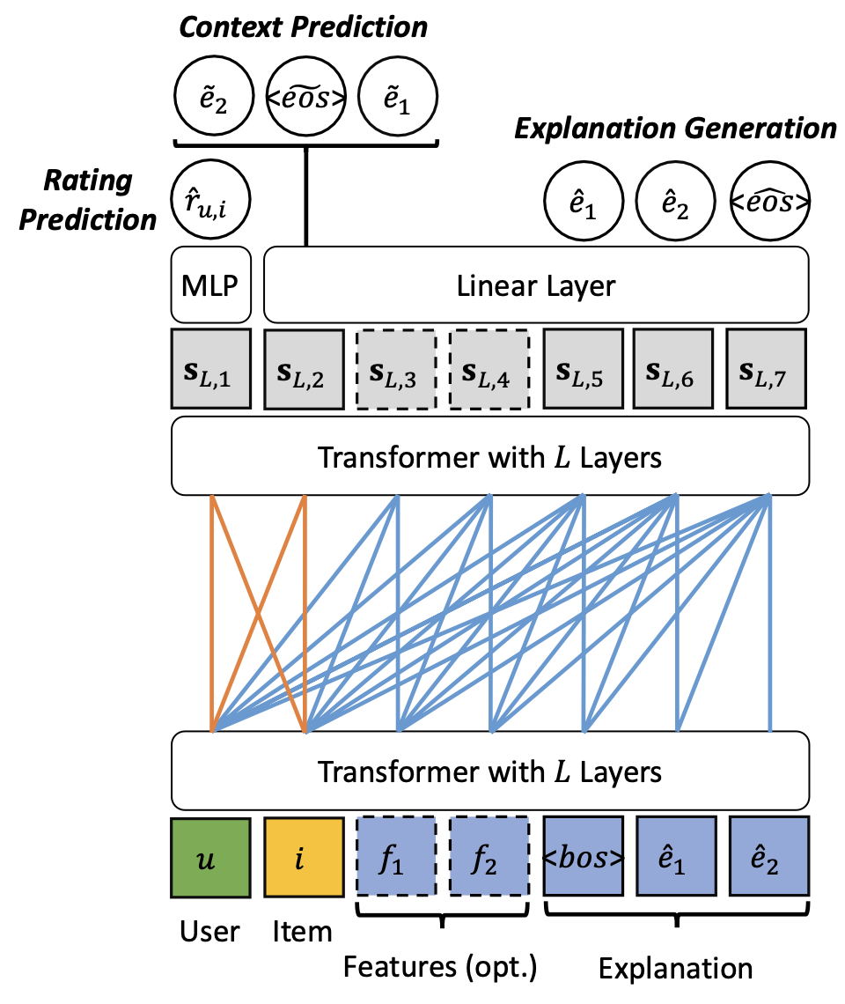
Prediction
Transformer and Attention Mask
Input

Slide 11
Input / Output
Input:
• user ID 𝑢
• item ID 𝑖
• item’s features
• explanation(extracted from review)
• rating
Output: • explanation
• rating

Slide 12
Input representation
ID
Text
Input :
embedding
Input for Transformer
3 sets of embedding:
• user
• item
• text
=> user IDs and item IDs do not add to This would result in an increased cost for prediction.

Slide 13
Transformer
Total have L layers:
A layer has 2 sub-layer:
Multi-head self-attention
Position-wise feed-forward network
Notes:
https://aclanthology.org/2020.emnlp-main.698.pdf
Fig. 1

Slide 14
Transformer
Notes:
https://aclanthology.org/2020.emnlp-main.698.pdf
Fig. 1

Slide 15
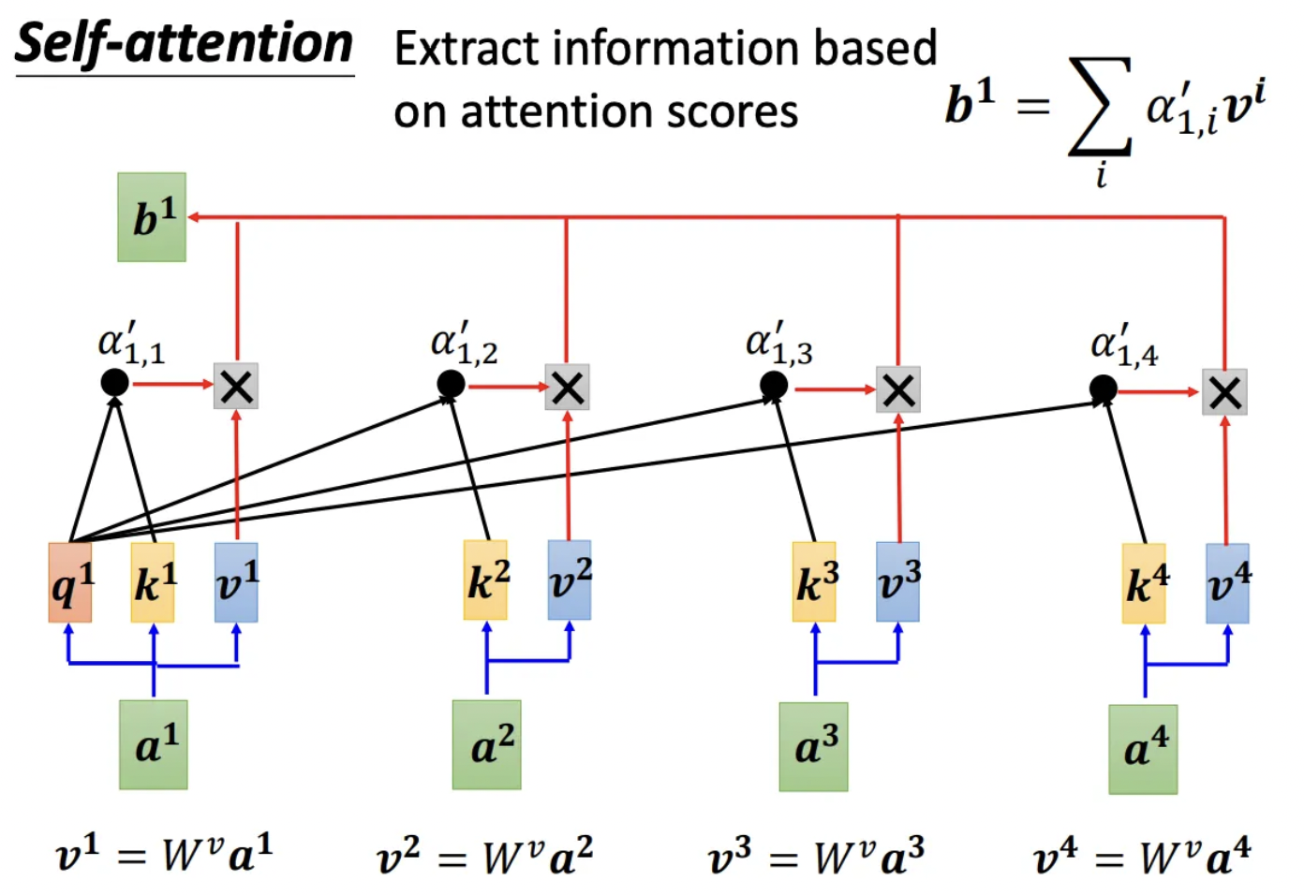
self-attention
Notes:
https://aclanthology.org/2020.emnlp-main.698.pdf
Fig. 1

Slide 16
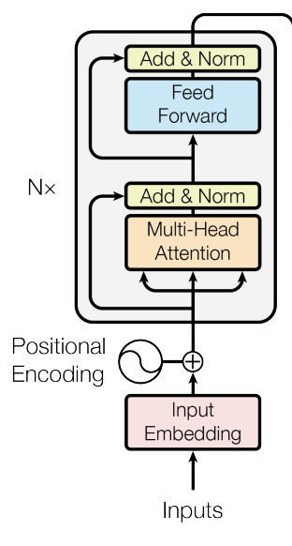
self-attention
Notes:
https://aclanthology.org/2020.emnlp-main.698.pdf
Fig. 1

Slide 17
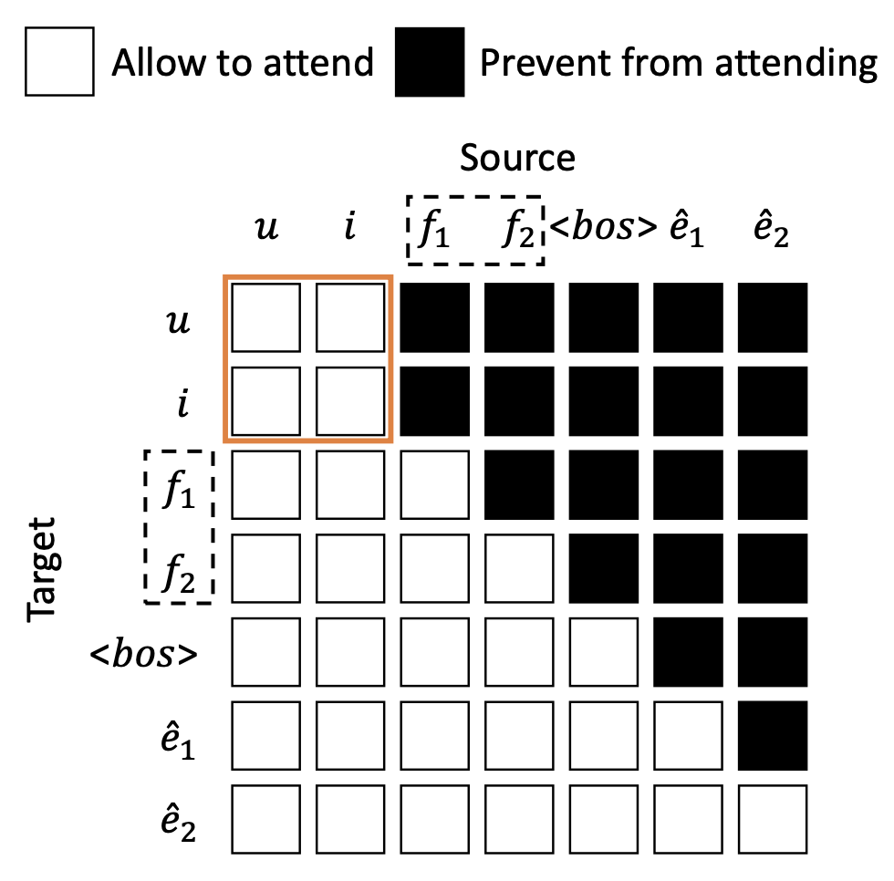
self-attention
Notes:
https://aclanthology.org/2020.emnlp-main.698.pdf
Fig. 1

Slide 18
self-attention
• Insertion-based generation
- Generate
- Preprocess
Notes:
https://aclanthology.org/2020.emnlp-main.698.pdf
Fig. 1

Slide 19
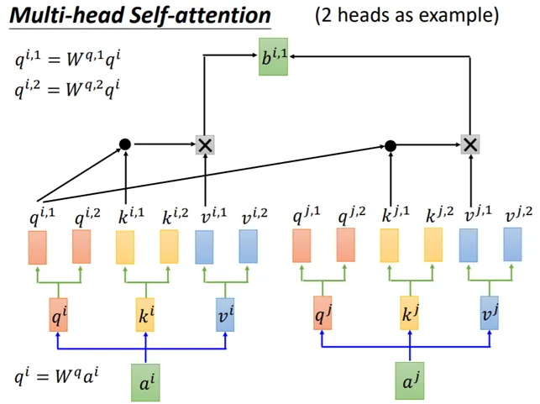
Attention

Slide 20
Prediction
L-layer’s output :
Predict the probability of each vocabulary at position t
Notes:
https://aclanthology.org/2020.emnlp-main.698.pdf
Fig. 1

Slide 21
Loss
Explanation generation loss:
Pass user, item, features
Context prediction loss:
User and item are allowed to attend to each other
Notes:
https://aclanthology.org/2020.emnlp-main.698.pdf
Fig. 1

Slide 22
Loss
2nd is used for context prediction
Recommendation loss:
Multi-task learning:
Notes:
https://aclanthology.org/2020.emnlp-main.698.pdf
Fig. 1

Slide 23
Outline
• Introduction
• Method
• Experiment
• Conclusion

Slide 24
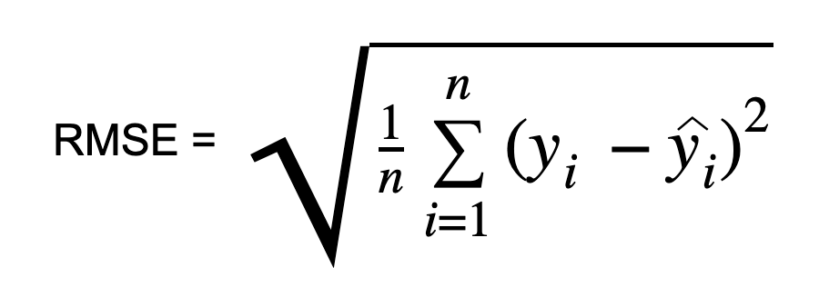
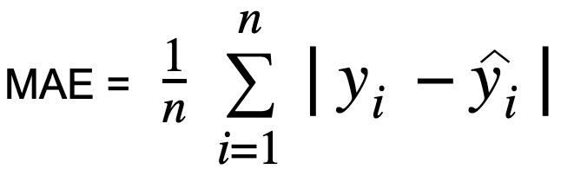
Experiment
• Evaluation
For rating
- Root Mean Square Error(RMSE)
- Mean Absolute Error(MAE)
Notes:
Use users with number of ratings greater than 5 and items with number of ratings greater than 10 in the Amazon dataset.
CG，cumulative gain DCG，Discounted cumulative gain
IDCG，ideal Discounted cumulative gain 理想的DCG
NDCG，Normalized Discounted cumulative gain
首先对语料库中所有相关文档的相关性排序，再通过位置 p生成最大可能的 DCG ，也称为理想 DCG (IDCG)。

Slide 25
Experiment
• Evaluation
For Explanation
- BLEU
- ROUGE
- USR(Unique Sentence Ratio)
- FMR(Feature Matching Ratio)
- FCR(Feature Coverage Ratio)
- DIV(Feature Diversity)

Slide 26
Experiment
• Evaluation
For Explanation
- BLEU
(B1, B4)
- ROUGE
(R1-P, R1-R, R1-F, R2-P, R2-R, R2-F)

Slide 27
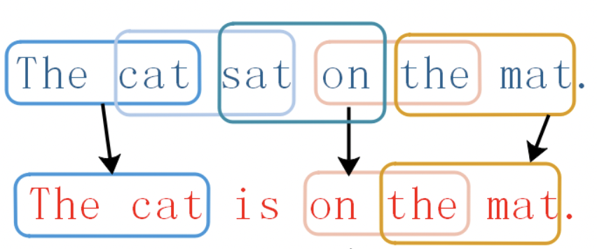
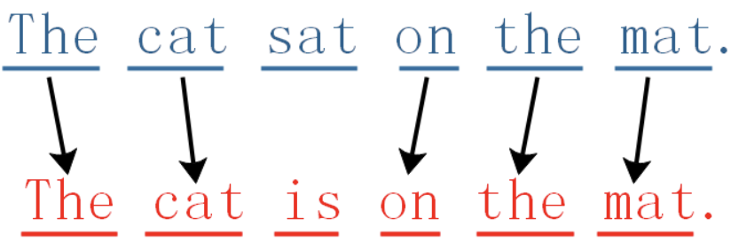
Experiment
• N-gram
1-gram
2-gram
candidate(C)
生成的句子
reference(R) 參考答案

Slide 28
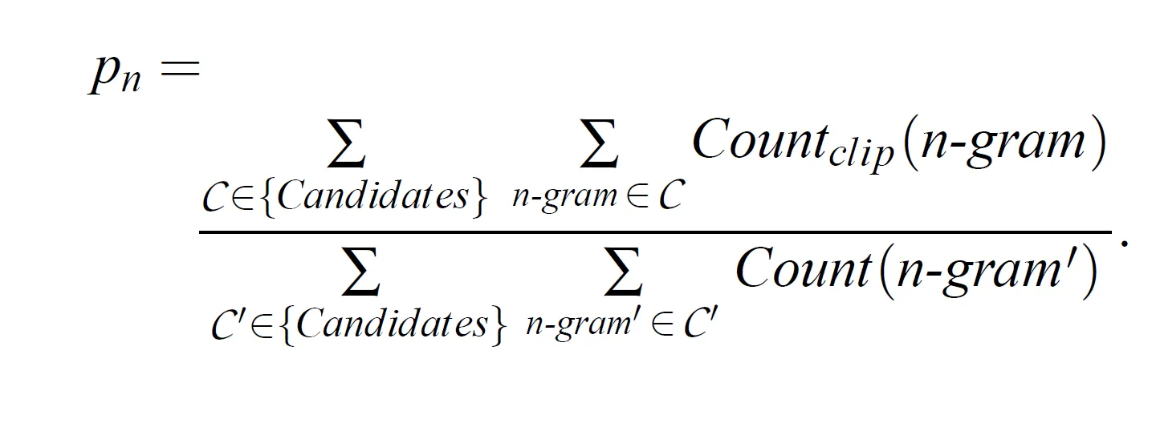
Experiment
• Evaluation
• BLEU
Candidate中uni-gram有幾個
1-gram
candidate(C)
生成的句子
6 個
reference(R) 參考答案

Slide 29
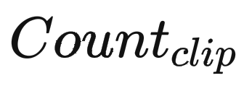
Experiment
Candidate : 生成的句子
Reference : 參考答案
• Evaluation
• BLEU
1-gram
candidate(C)
candidate中這個uni-gram出現的次數
reference(R)
reference 中這個uni-gram出現最多的次數
= min(1, max(1))
= 1

Slide 30
Experiment
Candidate : 生成的句子
Reference : 參考答案
• Evaluation
• BLEU
1-gram
candidate(C)
candidate中這個uni-gram出現的次數
reference(R)
reference 中這個uni-gram出現最多的次數

Slide 31
Experiment
Candidate : 生成的句子
Reference : 參考答案
• Evaluation
• BLEU
7 個the
2 個the
1 個te
candidate中這個uni-gram出現的次數
= min(7, max(2))
= 2
reference 中這個uni-gram出現最多的次數

Slide 32
Experiment
Candidate : 生成的句子
Reference : 參考答案
• Evaluation
• BLEU
7 個the
2 個the
1 個the
candidate中這個uni-gram出現的次數
= min(7, max(2, 1))
= 2
reference 中這個uni-gram出現最多的次數

Slide 33
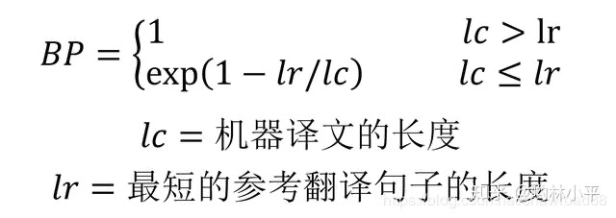
Experiment
• Evaluation
• BLEU
1-gram
candidate(C)
生成的句子
> 1
< 1
reference(R) 參考答案
P1 = 5/6

Slide 34
Experiment
• Evaluation
• BLEU as precision
1-gram
candidate(C)
生成的句子
reference(R) 參考答案
P1 = 5/6

Slide 35
Experiment
• Evaluation
For Explanation
- BLEU
(B1, B4)
- ROUGE
(R1-P, R1-R, R1-F, R2-P, R2-R, R2-F)
P: precision
R: recall
F: F1

Slide 36
Experiment
• Evaluation
• ROUGE

Slide 37
Experiment
• Evaluation
• ROUGE
Reference_count:
candidate_count:
overlap_count:
6
1-gram
6
candidate(C)
生成的句子
reference(R) 參考答案
5
R1-P = overlap_count / candidate_count
= 5/6
R1-R = overlap_count / reference_count
= 5/6 R1-F = 2 * [(P * R) / (P + R)]

Slide 38
Experiment
• Evaluation
• ROUGE
Reference_count:
candidate_count:
overlap_count:
6
1-gram
6
candidate(C)
生成的句子
reference(R) 參考答案
5
R1-P = overlap_count / candidate_count
= 5/6
R1-R = overlap_count / reference_count
= 5/6 R1-F = 2 * [(P * R) / (P + R)]

Slide 39
Experiment
• Evaluation
• ROUGE
1-gram
candidate(C)
生成的句子
reference(R) 參考答案
ROUGE-1 = 5/6

Slide 40
Experiment
• Evaluation
• ROUGE as recall
1-gram
candidate(C)
生成的句子
reference(R) 參考答案
ROUGE-1 = 5/6

Slide 41
Experiment
• Evaluation
• ROUGE-L
1-gram
candidate(C)
生成的句子
LCS : longest common subsequence
reference(R) 參考答案
m : len(reference)
ROUGE-L = 5/6

Slide 42
Experiment
• Evaluation
• BLEU as precision
• ROUGE as recall

Slide 43
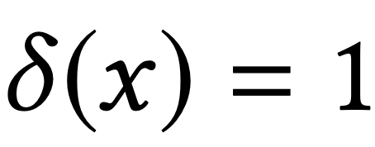
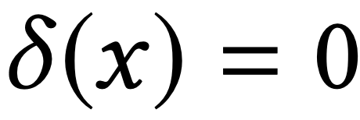
Experiment
• Evaluation
- USR(Unique Sentence Ratio)
- FMR(Feature Matching Ratio)
- FCR(Feature Coverage Ratio)
- DIV(Feature Diversity)
generated unique explanations
True :
False :
count(features)
number of features in the generated explanations
intersection of features
Notes:
FMR measures whether a generated explanation contains the feature in the ground-truth.
feature是否包含在內
FCR is computed as the number of distinct features contained in all the generated explanations, divided by the total number of features in the whole dataset.
包含了多少feature在生成句中（feature是全部有多少個）
DIV measures the intersection of features between any two generated explanations.
任二生成句中，重疊的feature的比例

Slide 44
Experiment
• Evaluation
- USR(Unique Sentence Ratio)
- FMR(Feature Matching Ratio)
- FCR(Feature Coverage Ratio)
- DIV(Feature Diversity)
generated unique explanations
True :
False :
count(features)
number of features in the generated explanations
intersection of features
Notes:
FMR measures whether a generated explanation contains the feature in the ground-truth.
feature是否包含在內
FCR is computed as the number of distinct features contained in all the generated explanations, divided by the total number of features in the whole dataset.
包含了多少feature在生成句中（feature是全部有多少個）
DIV measures the intersection of features between any two generated explanations.
任二生成句中，重疊的feature的比例

Slide 45
Experiment
• Dataset
- Yelp
- Amazon
- TripAdvisor
#recoders/user/item
0.0024
0.008
0.0052
Notes:
Use users with number of ratings greater than 5 and items with number of ratings greater than 10 in the Amazon dataset.
CG，cumulative gain DCG，Discounted cumulative gain
IDCG，ideal Discounted cumulative gain 理想的DCG
NDCG，Normalized Discounted cumulative gain
首先对语料库中所有相关文档的相关性排序，再通过位置 p生成最大可能的 DCG ，也称为理想 DCG (IDCG)。

Slide 46
Experiment
• Baseline
Explanation
•Add feature
- ACMLM
- NETE
•Without feature
- Transformer
- NRT
- Att2Seq

Slide 47
Experiment
• Baseline
- ACMLM: fine-tuned BERT based.
attention layer to incorporate features from both users and items
- NETE: GRU based.
incorporates a given feature into the decoding process

Slide 48
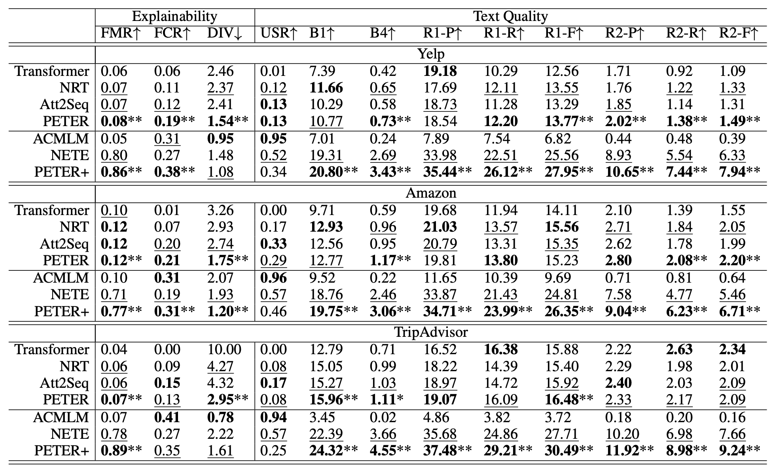
Experiment
Notes:
Generalized Matrix Factorization (GMF)
MF non-neural所以用GMF.DNN展示實用性
B = 0.2

Slide 49
Experiment
Notes:
Generalized Matrix Factorization (GMF)
MF non-neural所以用GMF.DNN展示實用性
B = 0.2

Slide 50
Experiment
percentage(%)
PETER+: PETER use features
Notes:
Generalized Matrix Factorization (GMF)
MF non-neural所以用GMF.DNN展示實用性
B = 0.2

Slide 51
Experiment
• PETER requires less training time compared to ACMLM

Slide 52
Experiment
• Using features for training leads to more accurate predictions of the features, rather than relying on common words.

Slide 53
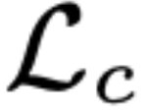
Experiment
• When disable the performances of both explainability and text quality drop dramatically
• When PETER masking is replaced by the Left-to-Right masking, the explanation and recommendation performance are both drop

Slide 54
Conclusion
• They propose a simple and effective solution to address the personalized generation problem of Transformer.
• Compared to previous methods, while achieving improvements, the training time has also decreased.

Slide 55
Attention

Slide 56
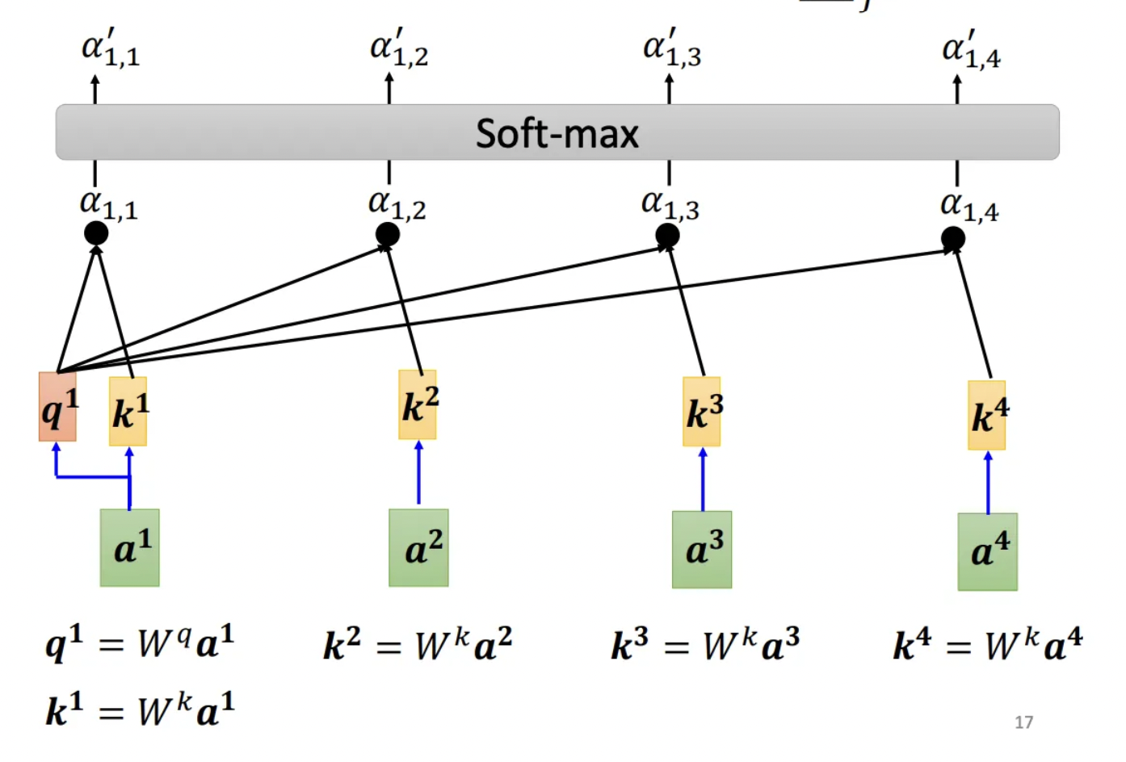
Attention

Slide 57
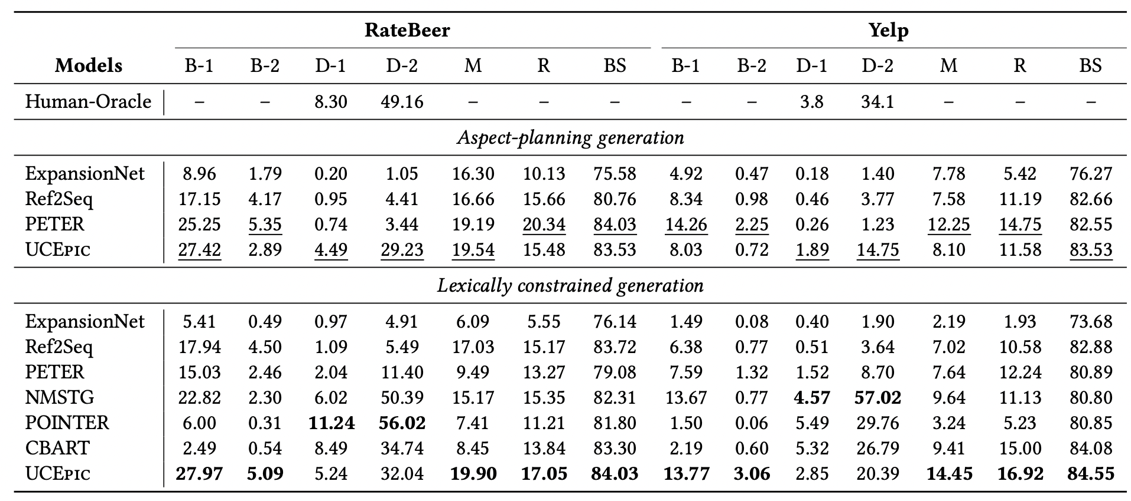
Experiment
• An appropriate aggregator is needed for different CDR scenarios.
Notes:
Generalized Matrix Factorization (GMF)
MF non-neural所以用GMF.DNN展示實用性
B = 0.2

Slide 58
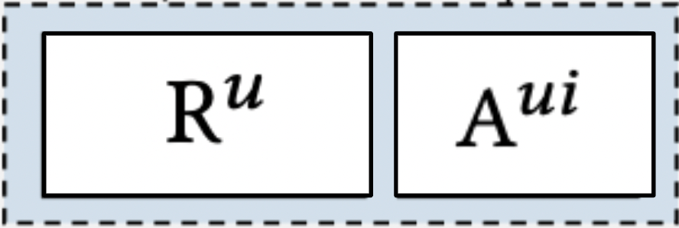
Fine-tune
Pre-train

Slide 60
SSCDR
• D
• B

Slide 61
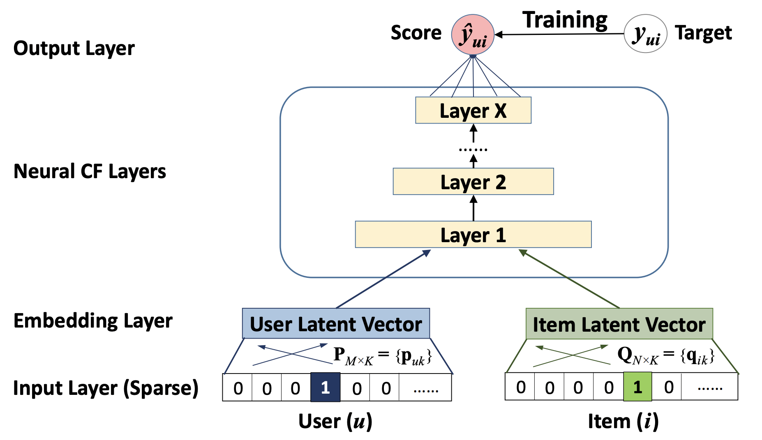
GMF

Slide 62
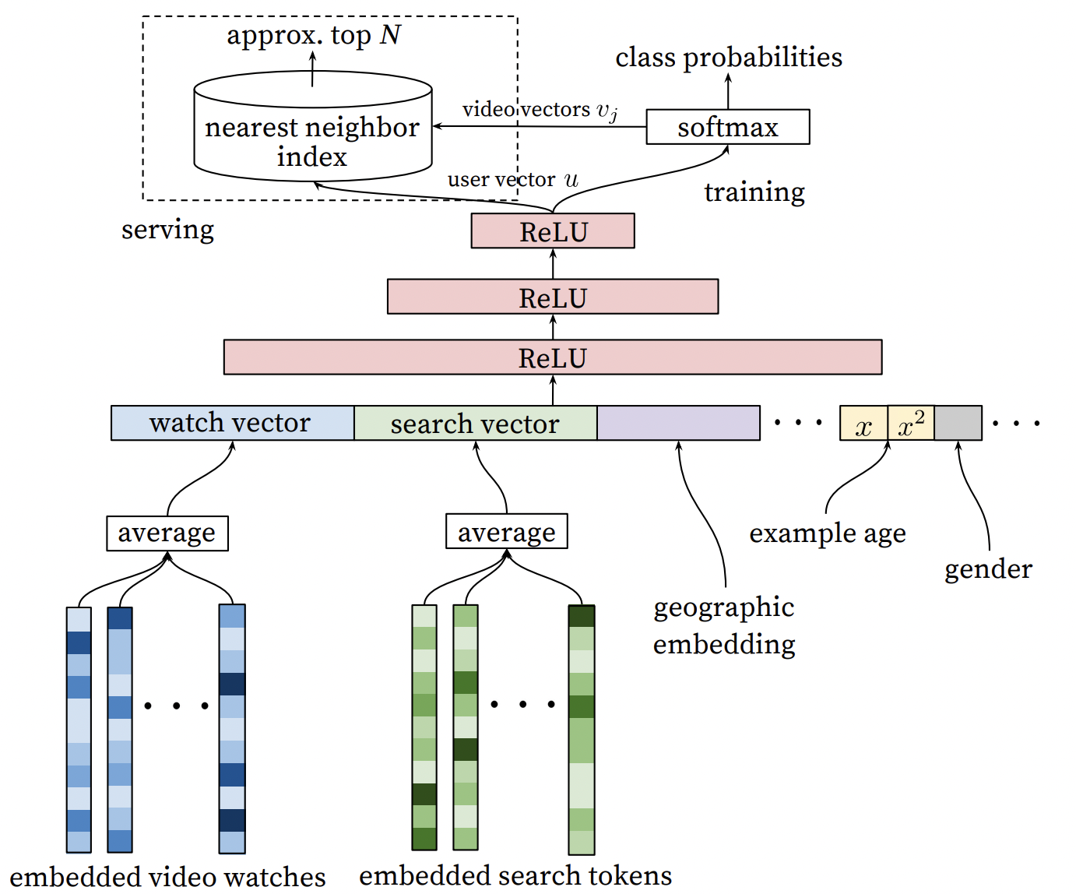
DNN

